Slide 1
Assemblers
System Software
by Leland L. Beck
Chapter 2

Slide 2
Role of Assembler
Assembler
Object
Code
Linker
Source
Program
Executable
Code
Loader
Chap 2

Slide 3
Chapter 2 -- Outline
Basic Assembler Functions
Machine-dependent Assembler Features
Machine-independent Assembler Features
Assembler Design Options
Chap 2

Slide 4
Introduction to Assemblers
Fundamental functions
  translating mnemonic operation codes to their machine language equivalents
  assigning machine addresses to symbolic labels
Machine dependency
  different machine instruction formats and codes
Chap 2

Slide 5
Example Program (Fig. 2.1)
Purpose
  reads records from input device (code F1)
  copies them to output device (code 05)
  at the end of the file, writes EOF on the output device, then RSUB to the operating system
  program
Chap 2

Slide 6
Example Program (Fig. 2.1)
Data transfer (RD, WD)
  a buffer is used to store record
  buffering is necessary for different I/O rates
  the end of each record is marked with a null character (00₁₆)
  the end of the file is indicated by a zero-length record
Subroutines (JSUB, RSUB)
  RDREC, WRREC
  save link register first before nested jump
Chap 2

Slide 7
Assembler Directives
Pseudo-Instructions
  Not translated into machine instructions
  Providing information to the assembler
Basic assembler directives
  START
  END
  BYTE
  WORD
  RESB
  RESW
Chap 2

Slide 8
Object Program
Header
  Col. 1 H
  Col. 2~7 Program name
  Col. 8~13 Starting address (hex)
  Col. 14-19 Length of object program in bytes (hex)
Text
  Col.1 T
  Col.2~7 Starting address in this record (hex)
  Col. 8~9 Length of object code in this record in bytes (hex)
  Col. 10~69 Object code (69-10+1)/6=10 instructions
End
  Col.1 E
  Col.2~7 Address of first executable instruction (hex)
  (END program_name)
Chap 2

Slide 9
Fig. 2.3
H COPY 001000 00107A
T 001000 1E 141033 482039 001036 281030 301015 482061 ...
T 00101E 15 0C1036 482061 081044 4C0000 454F46 000003 000000
T 002039 1E 041030 001030 E0205D 30203F D8205D 281030 …
T 002057 1C 101036 4C0000 F1 001000 041030 E02079 302064 …
T 002073 07 382064 4C0000 05
E 001000
Chap 2

Slide 10
Figure 2.1 (Pseudo code)
Program copy {
save return address;
cloop: call subroutine RDREC to read one record;
if length(record)=0 {
call subroutine WRREC to write EOF;
} else {
call subroutine WRREC to write one record;
goto cloop;
}
load return address
return to caller
}
Chap 2

Slide 11
An Example (Figure 2.1, Cont.)
EOR:
character x‘00’
Subroutine RDREC {
clear A, X register to 0;
rloop: read character from input device to A register
if not EOR {
store character into buffer[X];
X++;
if X < maximum length
goto rloop;
}
store X to length(record);
return
}
Chap 2

Slide 12
An Example (Figure 2.1, Cont.)
Subroutine WDREC {
clear X register to 0;
wloop: get character from buffer[X]
write character from X to output device
X++;
if X < length(record)
goto wloop;
return
}
Chap 2

Slide 13
Assembler’s functions
Convert mnemonic operation codes to their machine language equivalents
Convert symbolic operands to their equivalent machine addresses ✓
Build the machine instructions in the proper format
Convert the data constants to internal machine representations
Write the object program and the assembly listing
Break...
Chap 2

Slide 14
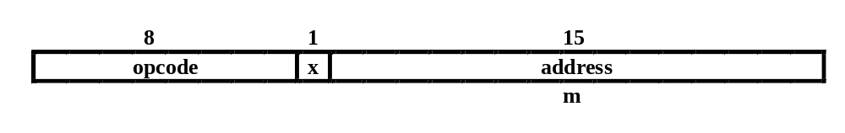
Example of Instruction Assemble
STCH BUFFER,X
549039
Forward reference
(54)₁₆ 1 (001)₂ (039)₁₆
Chap 2

Slide 15
Difficulties: Forward Reference
Forward reference: reference to a label that is defined later in the program.
Loc Label Operator Operand
1000 FIRST STL RETADR
1003 CLOOP JSUB RDREC
… … … … …
1012 J CLOOP
… … … … …
1033 RETADR RESW 1
Chap 2

Slide 16
Two Pass Assembler
Pass 1
  Assign addresses to all statements in the program
  Save the values assigned to all labels for use in Pass 2
  Perform some processing of assembler directives
Pass 2
  Assemble instructions
  Generate data values defined by BYTE, WORD
  Perform processing of assembler directives not done in Pass 1
  Write the object program and the assembly listing
Chap 2

Slide 17
Two Pass Assembler
Read from input line
  LABEL, OPCODE, OPERAND
Source
program
Intermediate
file
Object
codes
Pass 1
Pass 2
OPTAB
SYMTAB
SYMTAB
Chap 2

Slide 18
Data Structures
Operation Code Table (OPTAB)
Symbol Table (SYMTAB)
Location Counter(LOCCTR)
Chap 2

Slide 19
OPTAB (operation code table)
Content
  menmonic, machine code (instruction format, length) etc.
Characteristic
  static table
Implementation
  array or hash table, easy for search
Chap 2

Slide 20
SYMTAB (symbol table)
Content
  label name, value, flag, (type, length) etc.
Characteristic
  dynamic table (insert, delete, search)
Implementation
  hash table, non-random keys, hashing function
COPY 1000
FIRST 1000
CLOOP 1003
ENDFIL 1015
EOF 1024
THREE 102D
ZERO 1030
RETADR 1033
LENGTH 1036
BUFFER 1039
RDREC 2039
Chap 2

Slide 21
Homework #3
SUM START 4000
FIRST LDX ZERO
LDA ZERO
LOOP ADD TABLE,X
TIX COUNT
JLT LOOP
STA TOTAL
RSUB
TABLE RESW 2000
COUNT RESW 1
ZERO WORD 0
TOTAL RESW 1
END FIRST
End of Sec 2-1
Chap 2

Slide 22
Assembler Design
Machine Dependent Assembler Features
  instruction formats and addressing modes
  program relocation
Machine Independent Assembler Features
  literals
  symbol-defining statements
  expressions
  program blocks
  control sections and program linking
Chap 2

Slide 23
Machine-dependent
Assembler Features
Sec. 2-2
Instruction formats and addressing modes
Program relocation

Slide 24
Instruction Format and Addressing Mode
SIC/XE
  PC-relative or Base-relative addressing: op m
  Indirect addressing: op @m
  Immediate addressing: op #c
  Extended format: +op m
  Index addressing: op m,x
  register-to-register instructions
  larger memory -> multi-programming (program allocation)
Example program
Chap 2

Slide 25
Translation
Register translation
  register name (A, X, L, B, S, T, F, PC, SW) and their values (0,1, 2, 3, 4, 5, 6, 8, 9)
  preloaded in SYMTAB
Address translation
  Most register-memory instructions use program counter relative or base relative addressing
  Format 3: 12-bit address field
    base-relative: 0~4095
    pc-relative: -2048~2047
  Format 4: 20-bit address field
Chap 2

Slide 26
PC-Relative Addressing Modes
PC-relative
  10 0000 FIRST STL RETADR 17202D
  (14)₁₆ 1 1 0 0 1 0 (02D) ₁₆
    displacement= RETADR - PC = 30-3 = 2D
  40 0017 J CLOOP 3F2FEC
    (3C)₁₆ 1 1 0 0 1 0 (FEC) ₁₆
    displacement= CLOOP-PC= 6 - 1A= -14= FEC
Chap 2

Slide 27
Base-Relative Addressing Modes
Base-relative
  base register is under the control of the programmer
  12 LDB #LENGTH
  13 BASE LENGTH
  160 104E STCH BUFFER, X 57C003
  ( 54 )₁₆ 1 1 1 1 0 0 ( 003 ) ₁₆
  (54) 1 1 1 0 1 0 0036-1051= -101B₁₆
    displacement= BUFFER - B = 0036 - 0033 = 3
  NOBASE is used to inform the assembler that the contents of the base register no longer be relied upon for addressing
Chap 2

Slide 28
Immediate Address Translation
Immediate addressing
  55 0020 LDA #3 010003
  ( 00 )₁₆ 0 1 0 0 0 0 ( 003 ) ₁₆
  133 103C +LDT #4096 75101000
  ( 74 )₁₆ 0 1 0 0 0 1 ( 01000 ) ₁₆
Chap 2

Slide 29
Immediate Address Translation (Cont.)
Immediate addressing
  12 0003 LDB #LENGTH 69202D
  ( 68)₁₆ 0 1 0 0 1 0 ( 02D ) ₁₆
  ( 68)₁₆ 0 1 0 0 0 0 ( 033)₁₆ 690033
    the immediate operand is the symbol LENGTH
    the address of this symbol LENGTH is loaded into register B
    LENGTH=0033=PC+displacement=0006+02D
    if immediate mode is specified, the target address becomes the operand
Chap 2

Slide 30
Indirect Address Translation
Indirect addressing
  target addressing is computed as usual (PC-relative or BASE-relative)
  only the n bit is set to 1
  70 002A J @RETADR 3E2003
  ( 3C )₁₆ 1 0 0 0 1 0 ( 003 ) ₁₆
    TA=RETADR=0030
    TA=(PC)+disp=002D+0003
Chap 2

Slide 31
Program Relocation
Example Fig. 2.1
  Absolute program, starting address 1000
  e.g. 55 101B LDA THREE 00102D
  Relocate the program to 2000
  e.g. 55 101B LDA THREE 00202D
  Each Absolute address should be modified
Example Fig. 2.5:
  Except for absolute address, the rest of the instructions need not be modified
    not a memory address (immediate addressing)
    PC-relative, Base-relative
  The only parts of the program that require modification at load time are those that specify direct addresses
Chap 2

Slide 32
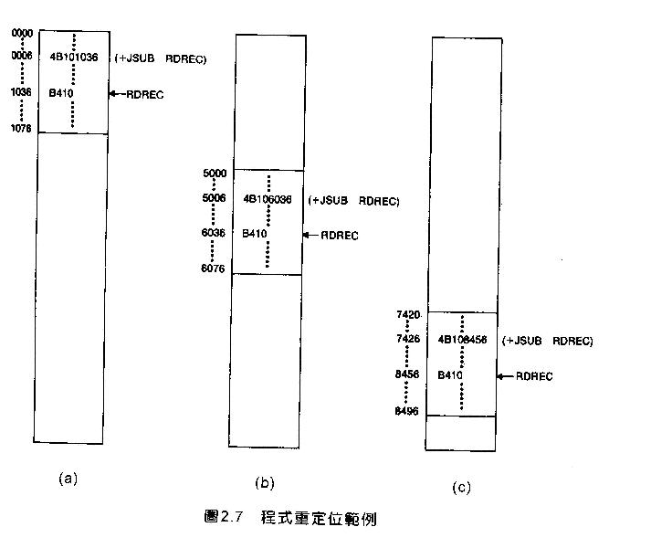
Example
Chap 2

Slide 33
Relocatable Program
Modification record
  Col 1 M
  Col 2-7 Starting location of the address field to be
  modified, relative to the beginning of the program
  Col 8-9 length of the address field to be modified, in half-
  bytes
Chap 2

Slide 34
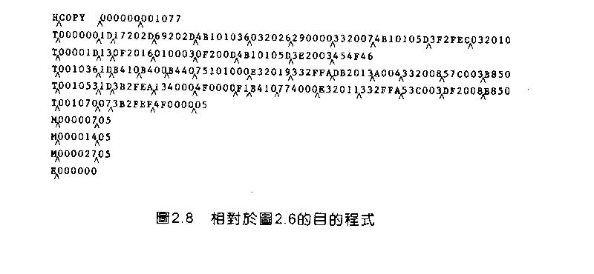
Object Code
End of Sec 2-2
Chap 2

Slide 35
Machine-Independent Assembler Features
Literals
Symbol Defining Statement
Expressions
Program Blocks
Control Sections and Program Linking

Slide 36
Literals
Design idea
  Let programmers to be able to write the value of a constant operand as a part of the instruction that uses it.
  This avoids having to define the constant elsewhere in the program and make up a label for it.
Example
  e.g. 45 001A ENDFIL LDA =C’EOF’ 032010
  93 LTORG
  002D * =C’EOF’ 454F46
  e.g. 215 1062 WLOOP TD =X’05’ E32011
Chap 2

Slide 37
Literals vs. Immediate Operands
Immediate Operands
  The operand value is assembled as part of the machine instruction
  e.g. 55 0020 LDA #3 010003
Literals
  The assembler generates the specified value as a constant at some other memory location
  e.g. 45 001A ENDFIL LDA =C’EOF’ 032010
Compare (Fig. 2.6)
  e.g. 45 001A ENDFIL LDA EOF 032010
  80 002D EOF BYTE C’EOF’ 454F46
Chap 2

Slide 38
Literal - Implementation (1/3)
Literal pools
  Normally literals are placed into a pool at the end of the program
    see Fig. 2.10 (END statement)
  In some cases, it is desirable to place literals into a pool at some other location in the object program
    assembler directive LTORG
    reason: keep the literal operand close to the instruction
Chap 2

Slide 39
Literal - Implementation (2/3)
Duplicate literals
  e.g. 215 1062 WLOOP TD =X’05’
  e.g. 230 106B WD =X’05’
  The assemblers should recognize duplicate literals and store only one copy of the specified data value
    Comparison of the defining expression
      Same literal name with different value, e.g. LOCCTR=*
    Comparison of the generated data value
      The benefits of using generate data value are usually not great enough to justify the additional complexity in the assembler
Chap 2

Slide 40
Literal - Implementation (3/3)
LITTAB
  literal name, the operand value and length, the address assigned to the operand
Pass 1
  build LITTAB with literal name, operand value and length, leaving the address unassigned
  when LTORG statement is encountered, assign an address to each literal not yet assigned an address
Pass 2
  search LITTAB for each literal operand encountered
  generate data values using BYTE or WORD statements
  generate modification record for literals that represent an address in the program
Chap 2

Slide 41
Symbol-Defining Statements
Labels on instructions or data areas
  the value of such a label is the address assigned to the statement
Defining symbols
  symbol EQU value
  value can be:  constant,  other symbol,  expression
  making the source program easier to understand
  no forward reference
Chap 2

Slide 42
Symbol-Defining Statements
Example 1
  MAXLEN EQU 4096
  +LDT #MAXLEN
Example 2 (Many general purpose registers)
  BASE EQU R1
  COUNT EQU R2
  INDEX EQU R3
Example 3
  MAXLEN EQU BUFEND-BUFFER
  +LDT #4096
Chap 2

Slide 43
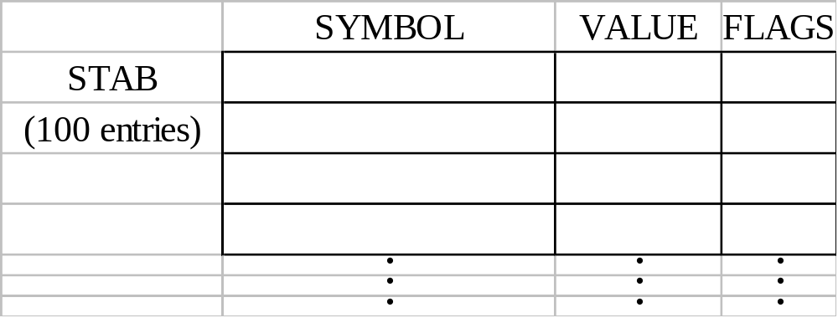
ORG (origin)
Indirectly assign values to symbols
Reset the location counter to the specified value
    ORG value
Value can be:  constant,  other symbol,  expression
No forward reference
Example
  SYMBOL: 6bytes
  VALUE: 1word
  FLAGS: 2bytes
  LDA VALUE, X
Chap 2

Slide 44
ORG Example
Using EQU statements
  STAB RESB 1100
  SYMBOL EQU STAB
  VALUE EQU STAB+6
  FLAG EQU STAB+9
Using ORG statements
  STAB RESB 1100
  ORG STAB
  SYMBOL RESB 6
  VALUE RESW 1
  FLAGS RESB 2
  ORG STAB+1100
Chap 2

Slide 45
Expressions
Expressions can be classified as absolute expressions or relative expressions
  MAXLEN EQU BUFEND-BUFFER
  BUFEND and BUFFER both are relative terms, representing addresses within the program
  However the expression BUFEND-BUFFER represents an absolute value
When relative terms are paired with opposite signs, the dependency on the program starting address is canceled out; the result is an absolute value
Chap 2

Slide 46
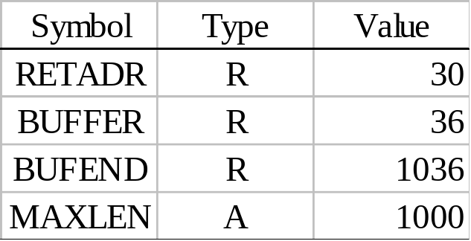
SYMTAB
None of the relative terms may enter into a multiplication or division operation
Errors:
  BUFEND+BUFFER
  100-BUFFER
  3*BUFFER
The type of an expression
  keep track of the types of all symbols defined in the program
Chap 2

Slide 47
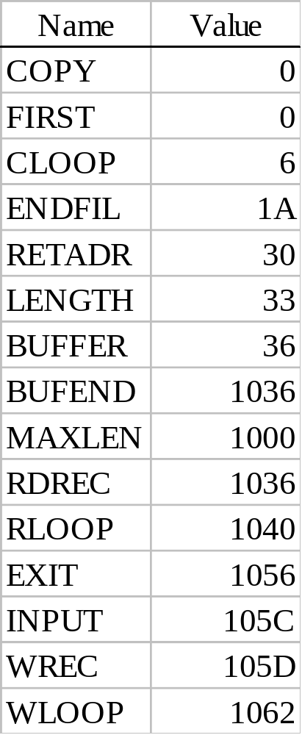
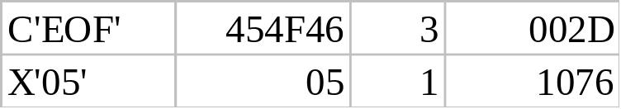
Example 2.9
SYMTAB LITTAB
Chap 2

Slide 48
Program Blocks
Program blocks
  refer to segments of code that are rearranged within a single object program unit
  USE [blockname]
  Default block
  Example: Figure 2.11
  Each program block may actually contain several separate segments of the source program
Chap 2

Slide 49
Program Blocks - Implementation
Pass 1
  each program block has a separate location counter
  each label is assigned an address that is relative to the start of the block that contains it
  at the end of Pass 1, the latest value of the location counter for each block indicates the length of that block
  the assembler can then assign to each block a starting address in the object program
Pass 2
  The address of each symbol can be computed by adding the assigned block starting address and the relative address of the symbol to that block
Chap 2

Slide 50
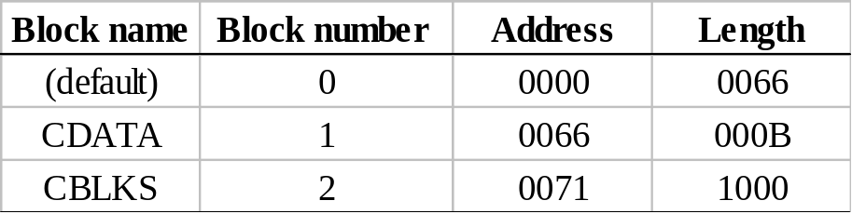
Figure 2.12
Each source line is given a relative address assigned and a block number
For absolute symbol, there is no block number
  line 107
Example
  20 0006 0 LDA LENGTH 032060
  LENGTH=(Block 1)+0003= 0066+0003= 0069
  LOCCTR=(Block 0)+0009= 0009
Chap 2

Slide 51
Program Readability
Program readability
  No extended format instructions on lines 15, 35, 65
  No needs for base relative addressing (line 13, 14)
  LTORG is used to make sure the literals are placed ahead of any large data areas (line 253)
Object code
  It is not necessary to physically rearrange the generated code in the object program
  see Fig. 2.13, Fig. 2.14
Chap 2

Slide 52
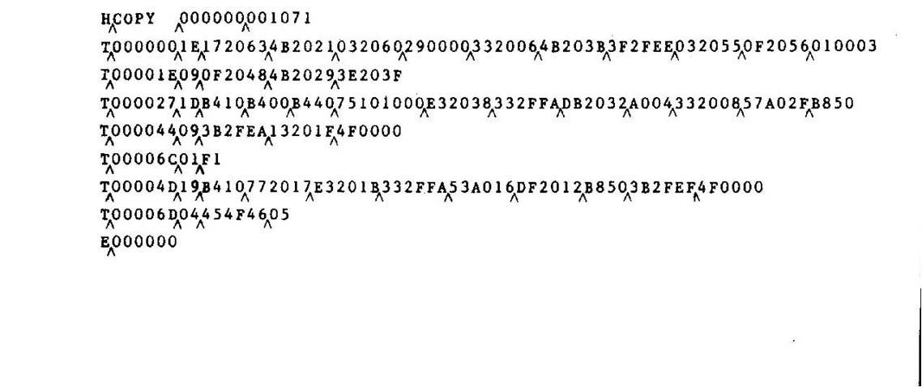
Chap 2

Slide 53
Control Sections and Program Linking
Control Sections
  are most often used for subroutines or other logical subdivisions of a program
  the programmer can assemble, load, and manipulate each of these control sections separately
  instruction in one control section may need to refer to instructions or data located in another section
  because of this, there should be some means for linking control sections together
  Fig. 2.15, 2.16
Chap 2

Slide 54
External Definition and References
External definition
  EXTDEF name [, name]
  EXTDEF names symbols that are defined in this control section and may be used by other sections
External reference
  EXTREF name [,name]
  EXTREF names symbols that are used in this control section and are defined elsewhere
Example
  15 0003 CLOOP +JSUB RDREC 4B100000
  160 0017 +STCH BUFFER,X 57900000
  190 0028 MAXLEN WORD BUFEND-BUFFER 000000
Chap 2

Slide 55
Implementation
The assembler must include information in the object program that will cause the loader to insert proper values where they are required
Define record
  Col. 1 D
  Col. 2-7 Name of external symbol defined in this control section
  Col. 8-13 Relative address within this control section (hexadeccimal)
  Col.14-73 Repeat information in Col. 2-13 for other external symbols
Refer record
  Col. 1 D
  Col. 2-7 Name of external symbol referred to in this control section
  Col. 8-73 Name of other external reference symbols
Chap 2

Slide 56
Modification Record
Modification record
  Col. 1 M
  Col. 2-7 Starting address of the field to be modified (hexiadecimal)
  Col. 8-9 Length of the field to be modified, in half-bytes (hexadeccimal)
  Col.11-16 External symbol whose value is to be added to or subtracted from the indicated field
  Note: control section name is automatically an external symbol, i.e. it is available for use in Modification records.
Example
  Figure 2.17
  M00000405+RDREC
  M00000705+COPY
Chap 2

Slide 57
External References in Expression
Earlier definitions
  required all of the relative terms be paired in an expression (an absolute expression), or that all except one be paired (a relative expression)
New restriction
  Both terms in each pair must be relative within the same control section
  Ex: BUFEND-BUFFER
  Ex: RDREC-COPY
In general, the assembler cannot determine whether or not the expression is legal at assembly time. This work will be handled by a linking loader.
Chap 2

Slide 58
Assembler Design Options
One-pass assemblers
Multi-pass assemblers
Two-pass assembler with overlay structure

Slide 59
Two-Pass Assembler with Overlay Structure
For small memory
  pass 1 and pass 2 are never required at the same time
  three segments
    root: driver program and shared tables and subroutines
    pass 1
    pass 2
  tree structure
  overlay program
Chap 2

Slide 60
One-Pass Assemblers
Main problem
  forward references
    data items
    labels on instructions
Solution
  data items: require all such areas be defined before they are referenced
  labels on instructions: no good solution
Chap 2

Slide 61
One-Pass Assemblers
Main Problem
  forward reference
    data items
    labels on instructions
Two types of one-pass assembler
  load-and-go
    produces object code directly in memory for immediate execution
  the other
    produces usual kind of object code for later execution
Chap 2

Slide 62
Load-and-go Assembler
Characteristics
  Useful for program development and testing
  Avoids the overhead of writing the object program out and reading it back
  Both one-pass and two-pass assemblers can be designed as load-and-go.
  However one-pass also avoids the over head of an additional pass over the source program
  For a load-and-go assembler, the actual address must be known at assembly time, we can use an absolute program
Chap 2

Slide 63
Forward Reference in One-pass Assembler
For any symbol that has not yet been defined
  1. omit the address translation
  2. insert the symbol into SYMTAB, and mark this symbol undefined
  3. the address that refers to the undefined symbol is added to a list of forward references associated with the symbol table entry
  4. when the definition for a symbol is encountered, the proper address for the symbol is then inserted into any instructions previous generated according to the forward reference list
Chap 2

Slide 64
Load-and-go Assembler (Cont.)
At the end of the program
  any SYMTAB entries that are still marked with * indicate undefined symbols
  search SYMTAB for the symbol named in the END statement and jump to this location to begin execution
The actual starting address must be specified at assembly time
Example
  Figure 2.18, 2.19
Chap 2

Slide 65
Producing Object Code
When external working-storage devices are not available or too slow (for the intermediate file between the two passes
Solution:
  When definition of a symbol is encountered, the assembler must generate another Tex record with the correct operand address
  The loader is used to complete forward references that could not be handled by the assembler
  The object program records must be kept in their original order when they are presented to the loader
Example: Figure 2.20
Chap 2

Slide 66
Multi-Pass Assemblers
Restriction on EQU and ORG
  no forward reference, since symbols’ value can’t be defined during the first pass
Example
  Use link list to keep track of whose value depend on an undefined symbol
Figure 2.21
Chap 2

